Slide 1

AGE 310: Instrumentation and Measurements
Lecture 5: Piezoelectric & Photoelectric Transducers
Instructor: Dr. Kadeghe Fue
Department of Agricultural Engineering
Sokoine University of Agriculture (SUA)

Slide 2


Recap & Objectives
Recap: Lecture 4
Lecture 5 Objectives
We covered Capacitive (Soil Moisture) and Inductive (LVDT, Proximity) transducers.
Understand the Piezoelectric Effect for generating charge from force.
Analyze applications: Accelerometers and Knock Sensors.
Explore Photoelectric principles (Light → Electricity).
Examine LDRs, Photodiodes, and Optical Encoders.
Discuss agricultural applications like Seed Counting.

Slide 3

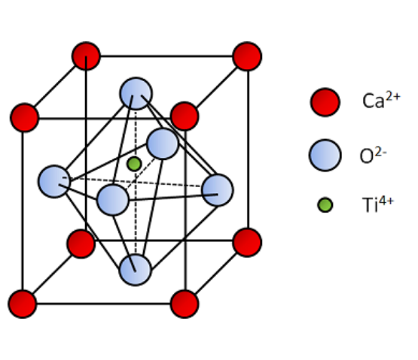
1. Piezoelectric Transducers
The Piezoelectric Effect
When certain asymmetrical crystals are mechanically deformed (compressed or stretched), electric charges accumulate on their opposite faces.
Key Concept: This is a reversible process. Applying voltage causes the crystal to deform (used in buzzers).
Formula:
(Charge = sensitivity × Force)

Slide 4







Piezoelectric Materials
Natural Crystals
Synthetic Ceramics
Polymers
Quartz: Highly stable, mechanically strong, but lower sensitivity.
PZT (Lead Zirconate Titanate): High sensitivity, cheaper, but less stable over temperature.
PVDF: Flexible plastic films.
Used in touch sensors and vibration strips.
Used in high-quality sensors and watches.
Most common in industrial sensors.

Slide 5

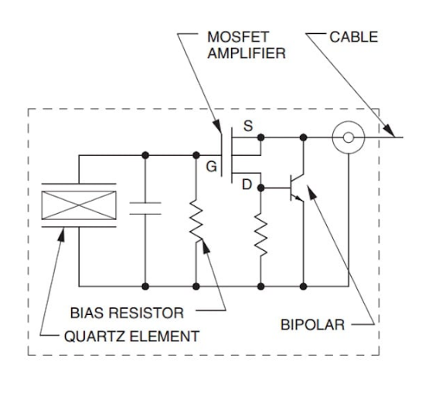
Application: The Accelerometer
Vibration Sensing
Accelerometers measure proper acceleration ("g-force").
Construction: A seismic mass is placed on top of a piezoelectric crystal. As the sensor vibrates, the mass exerts a changing force ( ) on the crystal.
This generates a voltage proportional to the vibration/acceleration.

Slide 6

Piezo in Agriculture
Combine Harvester Loss Sensors
Engine Knock Sensors
Piezo plates are mounted at the rear of the sieve.
Mounted on the engine block of tractors.
If grain kernels hit the plate, they create a specific high-frequency "ping" (vibration). Straw creates a dull "thud".
Detects the high-frequency vibration caused by improper combustion (knocking).
The ECU retards timing to protect the engine.
The sensor counts the pings to estimate grain loss.

Slide 7
Piezo Characteristics
Advantages
Disadvantages
High Frequency Response: Can detect very fast events (explosions, vibrations).
No Static Measurement: Charge leaks away quickly. Cannot measure constant weight or static pressure.
Self-Generating: Active transducer (needs no external power to generate charge).
High Impedance: Requires special cables and charge amplifiers to prevent signal loss.
Rugged: Solid state, no moving parts.

Slide 8
2. Photoelectric Transducers
Converting Light Energy into Electrical Energy
Essential for automation, safety, and precision farming.

Slide 9

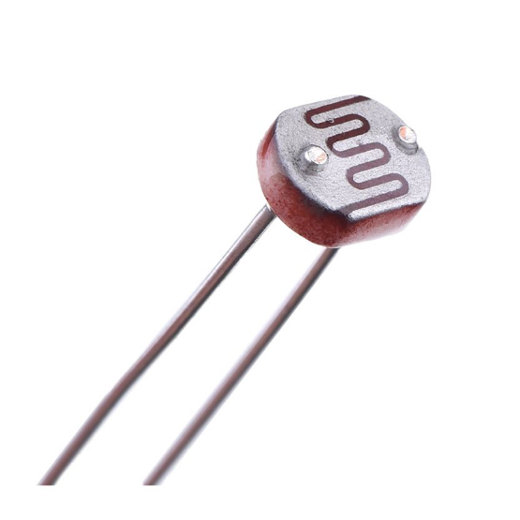
Light Dependent Resistor (LDR)
Principle (Photoconductive)
Made of semiconductor material like Cadmium Sulfide (CdS).
Dark: High Resistance (Megaohms).
Light: Photons provide energy for electrons to jump the band gap, increasing conductivity.
Resistance drops drastically in light.

Slide 10






Photodiodes & Phototransistors
Photodiode
Phototransistor
Operates in Reverse Bias.
Like a normal transistor, but the Base current is generated by light.
When light hits the junction, a small leakage current flows.
More sensitive than a photodiode (amplifies the signal) but slower.
Very fast response time (nanoseconds).

Slide 11
Photovoltaic Transducers (Solar Cells)
Principle
Usage
Generates a voltage when illuminated.
Power Generation: Solar panels for farm energy.
An Active transducer (needs no external power).
Sensing: Used in light meters (pyranometers) to measure solar radiation intensity ( ) for crop growth models.
Based on the P-N junction. Photons knock electrons loose, creating a potential difference.

Slide 12
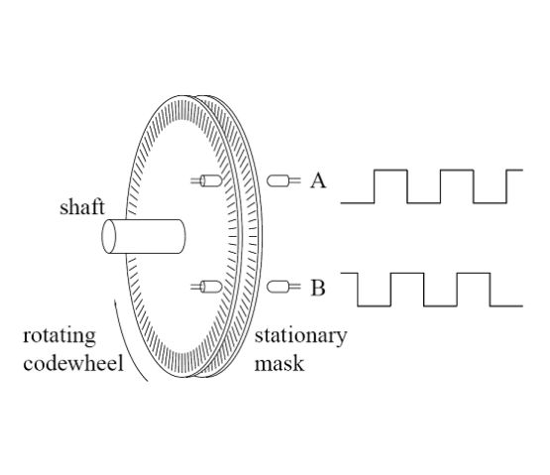
Optical Encoders
Measuring Speed & Position
Consists of a light source (LED), a slotted disc, and a light detector.
Incremental: Counts pulses to determine speed (RPM) or relative motion.
Absolute: Uses a unique code pattern to determine exact angle (0-360°).

Slide 13
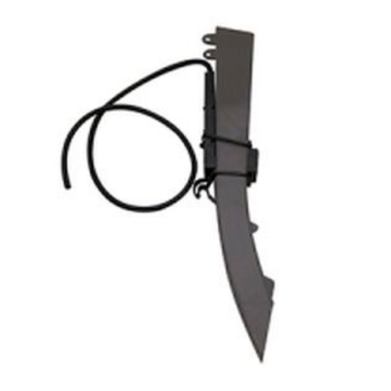
Ag Application: Seed Counting
Planter Monitoring
Optical sensors are placed in the seed tubes of a planter.
As a seed falls, it breaks the light beam.
The computer counts the pulses to calculate Population (seeds/acre) and Singulation (skips/doubles).
Essential for precision planting.

Slide 14
Ag Application: Weed Detection
"GreenSeeker" Technology
Spot Spraying
Uses active light sources (Red and NIR) to sense plant health (NDVI).
Cameras or spectral sensors detect the presence of green weeds on bare soil (fallow).
Healthy plants absorb Red light and reflect NIR.
The system triggers a nozzle to spray only the weed, saving 90% of herbicide.

Slide 15
Comparison: Photoelectric Types
Type | Principle | Response Time | Main Application
LDR | Change Resistance | Slow (ms) | Street lights (Dusk/Dawn)
Photodiode | Leakage Current | Fast (ns) | Optical Communications
Phototransistor | Current Gain | Medium | Object detection, Switches
Photovoltaic | Generate Voltage | N/A | Solar Power, Radiation Sensing

Slide 16
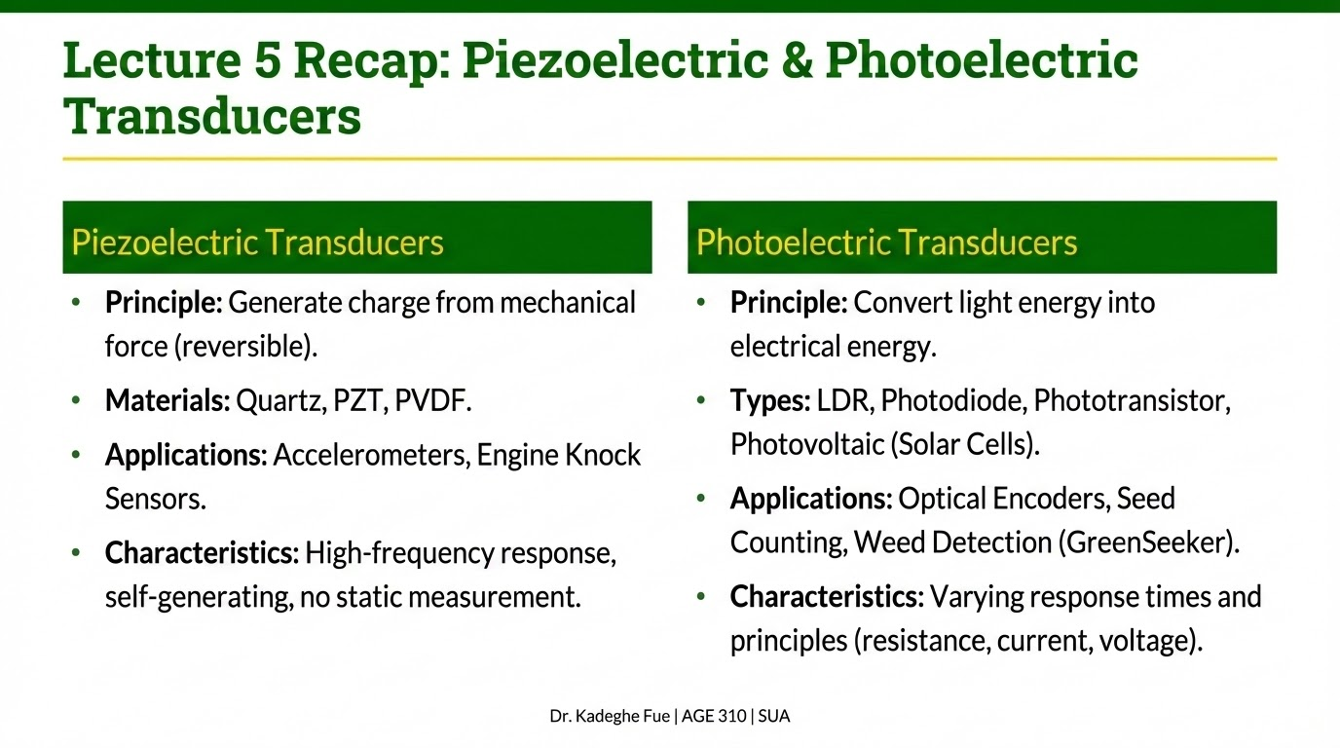

Slide 17

Discussion & Questions
End of Lecture 5
Next Class: Signal Conditioning (Amplifiers, Filters, and A/D Conversion).
Dr. Kadeghe Fue | AGE 310 | SUA

